Slide 1


Aldel Education Trust’s
St. John College of Engineering and Management, Palghar
NAAC Accredited with Grade A (2017-2022)
Department of Computer Engineering
Tour package recommendation system using collaborative filtering
Nidhi Agrawal PID:EU2181017 02_B
Himanshu Kushwaha PID:EU2182011 18_B
Saujanya Shetty PID:EU1182047 52_B
Under the guidance of
Mrs. Rashmi Bhat.
(Professor)
May 29, 2021

Slide 2
CONTENTS
Abstract
Introduction
Literature Review
Proposed System (Block diagram)
Implementation
Results and Discussion
Conclusion
Future Scope (if any)
References

Slide 3
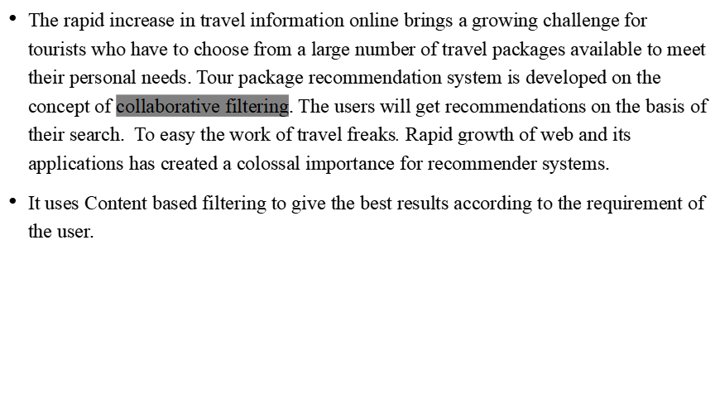
Abstract

Slide 4
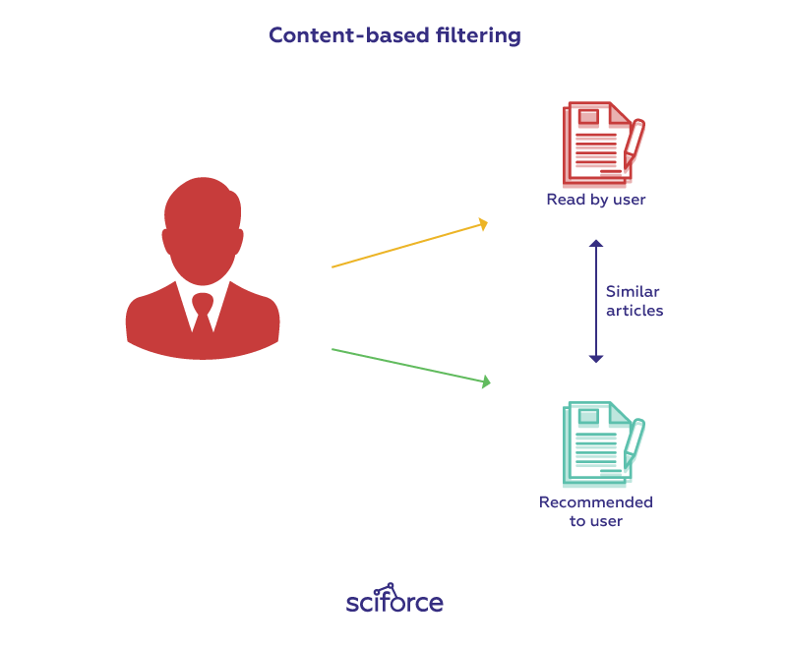
Introduction
Recommendation Systems: Recommendation systems provide users with personalized suggestions for products or services
Content based filtering: Content-based filtering uses item features to recommend other items similar to what the user likes, based on their previous actions or explicit feedback. To demonstrate content-based filtering.

Slide 5
Collaborative Filtering
These techniques are used in the earliest and most researched recommender systems (see (Breese, 1998; Resnick, 1994)). Often also referred to as social filtering, these algorithms focus on the behavior of users on items, which are to be recommended, rather than on the internal nature of the items themselves. The social approach is the technical means, which most closely resembles the nature of ”real-life recommendations”. We can assume that these algorithms have a semantic affinity to both the concept of collaborating individuals and the process of finding persons with similar interest

Slide 6
Methodology
Content Based Filtering.
In our project we will be implementing content based filtering. We will take input from user for a particular city or place than provide user with all the options available in our database.
We will be using the database as provided in the following slide.

Slide 7
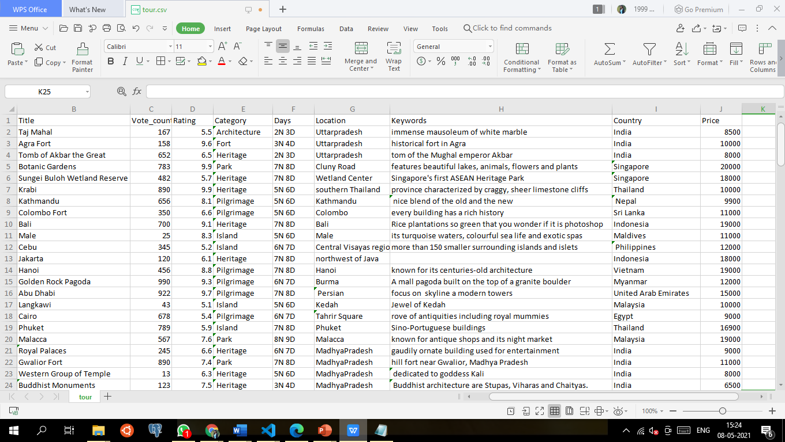
Dataset

Slide 8
Literature Review
Sr. No. | Paper Title [Ref.] | Author names | Conclusion | Research Gaps
[1] | Recommender Systems: An Overview, Research Trends, and Future Directions | Pradeep Kumar Singh*, Pijush Kanti Dutta Pramanik, Avick Kumar Dey and Prasenjit Choudhury | The RS will have a vast future scope and will witness several new technologies. | 2021
[2] | An Intelligent Destination Recommendation System for Tourists | Pree Thiengburanathum Doctor of Philosophy | The paper concluded with the saying that recommender systems can further be improvised in future | 2018

Slide 9
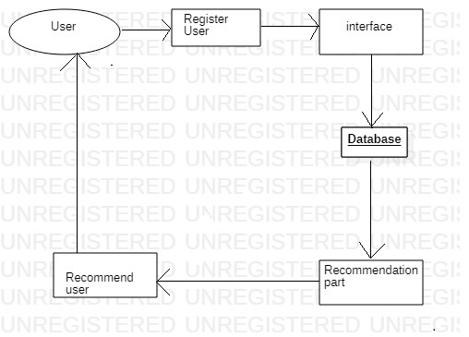
Proposed System
The proposed system will include the registration page the user first have to register. The recommendation phase will come later.

Slide 10
Implementation
Implementation phase include.
1.Prepare data.
2.Create Database in MYSQl
3.Working on the backend.
4. Working on frontend.

Slide 11
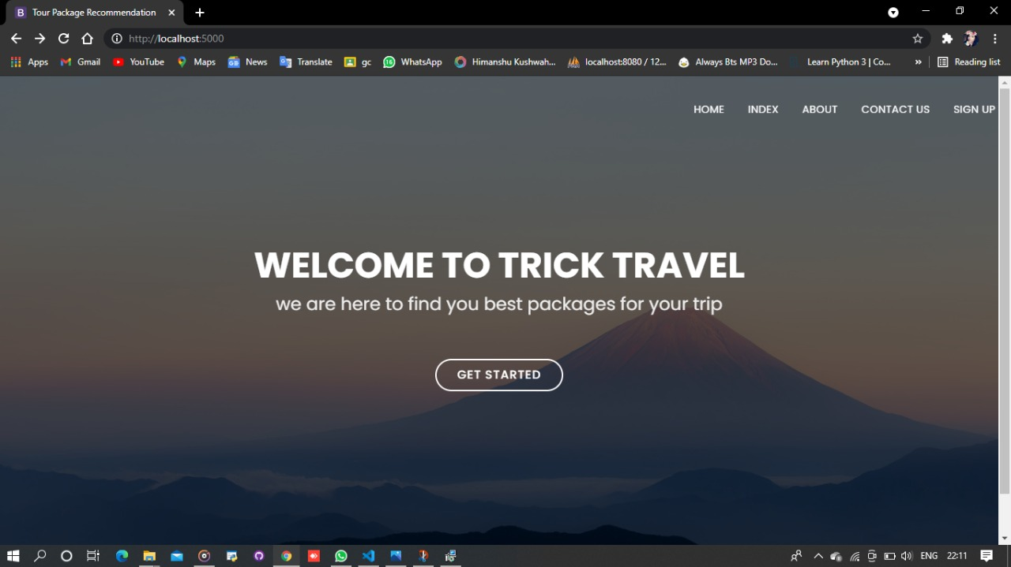
Frontend image

Slide 12
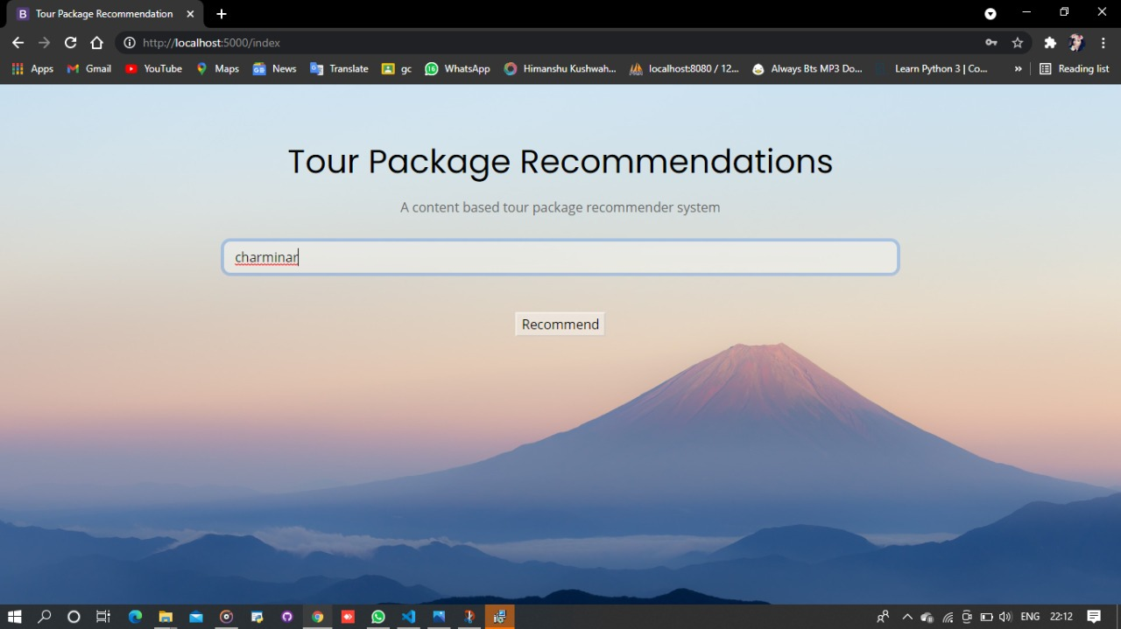
INDEX PAGE

Slide 13
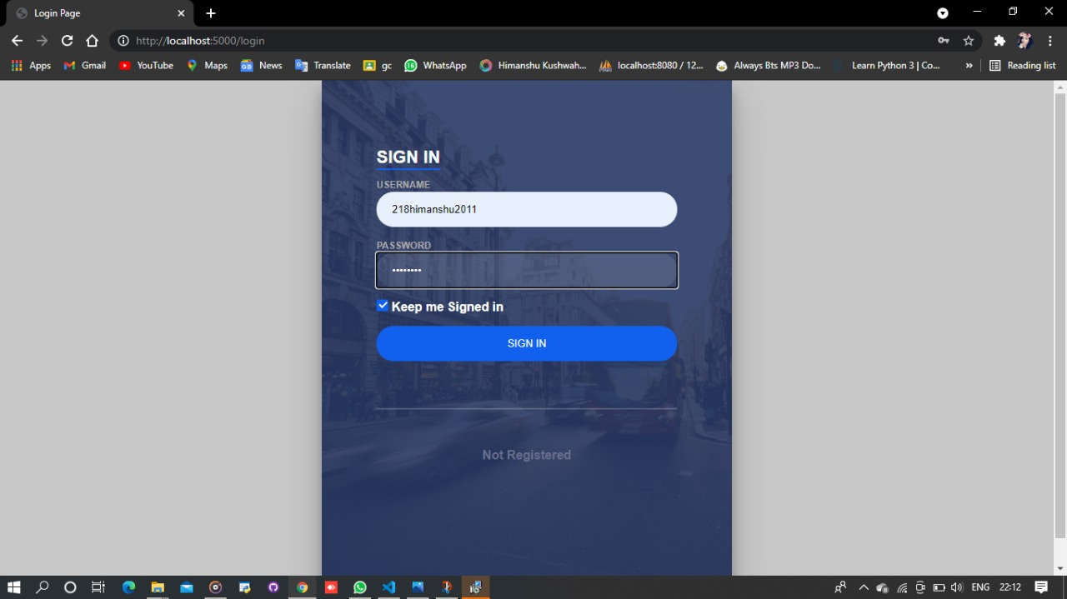
SIGN IN Page

Slide 14
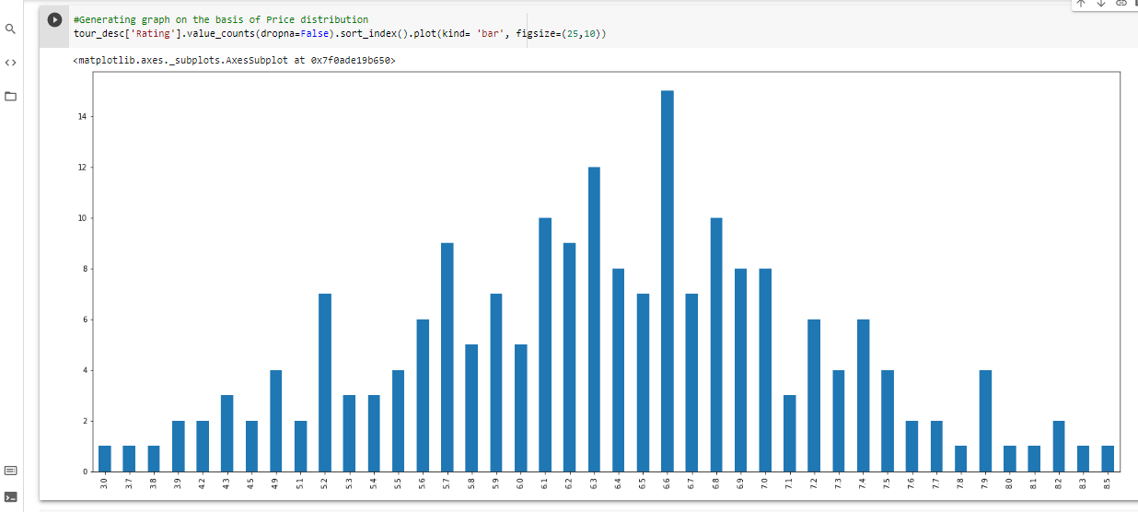
Building Graph with the attribute price

Slide 15
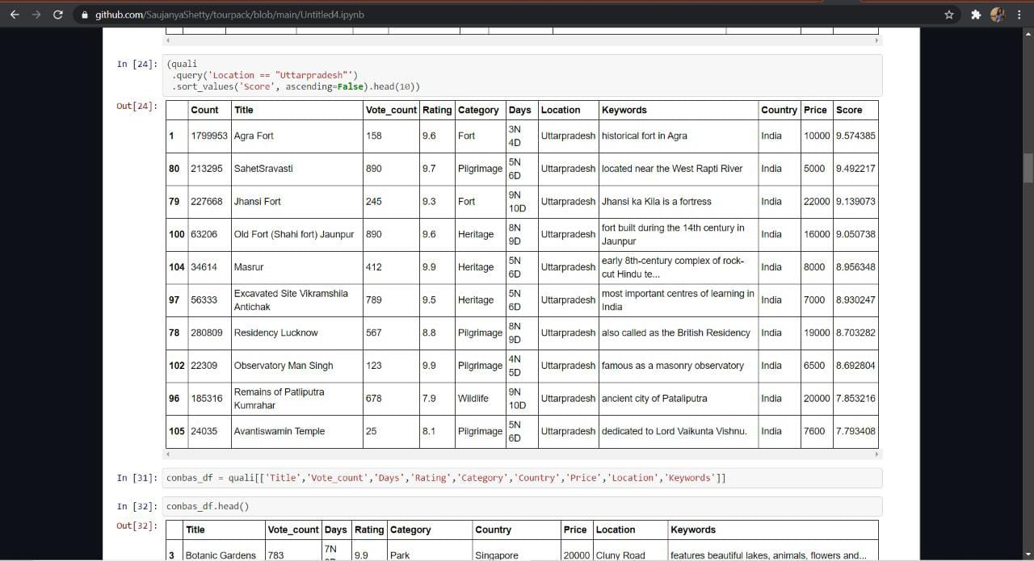
Recommendation of a place

Slide 16
Results and Discussion
The result of the project implemented till date is some features are working and we are facing some difficulties in further implementation which will be solved as soon as possible.
The project is implemented in google collab and it will be merged with frontend in the latter phase.

Slide 17
Conclusion
We would like to conclude the presentation with the following details
Our project is 65% completed because some of the implementation and work is still in progress.

Slide 18
References
1. January 2021International Journal of Business and Systems Research 15(1):14–52, Recommender Systems: An Overview, Research Trends, and Future Directions int. J. Business and Systems Research, Vol. 15, No. 1, 2021
An Intelligent Destination Recommendation System for Tourists Pree Thiengburanathum Doctor of Philosophy, March 2018

Slide 19
Thank You !!!

Slide 20
Q & A

